Slide 1

MLL212: MATH. METHODS IN MATERIALS ENGINEERING
Tutorial 1- Basics of MATLAB (learning by doing)
Course Instructor: Prof. Divya Nayar Department of Materials Science and Engineering
Indian Institute of Technology Delhi
Teaching Assistants
Sibasankar Panigrahy
Shivnandi
Poojalakshmi

Slide 2
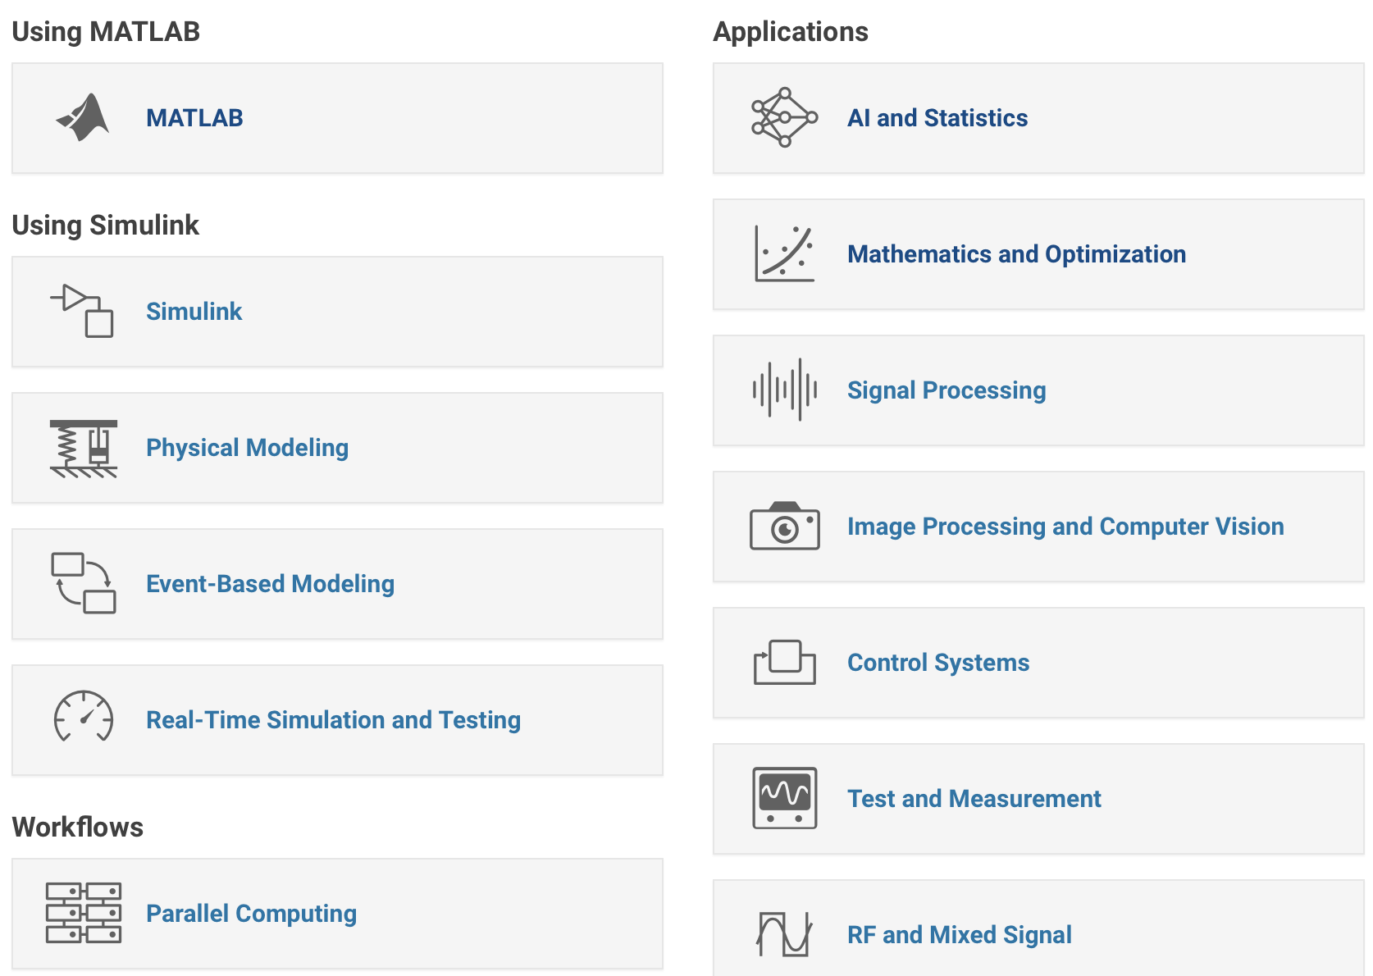

Slide 3
MATLAB help
For help, command description use F1 or following commands:
help command_name
helpwin command_name
doc command_name
lookfor keyword (search unknown command)
Magic(n)
n*(n**2-1)/2. sum of each column.

Slide 4
Some Useful commands
what List all m-files in current directory
dir/ls List all files in current directory
type test Display test.m in command window
delete test Delete test.m
cd/chdir Change directory
pwd Show current directory
which test Display directory path to ‘closest’ test.m
who List known variables
whos List known variables plus their size
clear Clear variables from workspace
clc Clear the command window
Note: terminate statement with semicolon (;) to suppress output.

Slide 5
Mathematical functions
Typing help elfun and help specfun calls up full lists of elementary and special functions respectively.
Elementary functions
Predefined constant values

Slide 6
MATRIX
Matrices are the basic elements of the MATLAB environment.
A matrix is a two-dimensional array consisting of m rows and n columns.
MATLAB supports two types of operations, known as matrix operations and array operations.
Creating a sub-matrix:
B = A([2 3],[1 2])

Slide 7
Basic plotting
The MATLAB command to plot a graph is plot(x,y).
The vectors x = (1, 2, 3, 4, 5, 6)
and y = (3,−1, 2, 4, 5, 1)
x = 0:pi/100:2*pi;
y = sin(x);
plot(x,y)
Multiple data sets in one plot
x = 0:pi/100:2*pi;
y1 = 2*cos(x);
y2 = cos(x);
y3 = 0.5*cos(x);
plot(x,y1,’--’,x,y2,’-’,x,y3,’:’)
legend(’2*cos(x)’,’cos(x)’,’0.5*cos(x)’)
axis([0 2*pi -3 3])

Slide 8
M-Files
Programming and Scripts
An M-file might be used as a script, i.e. file consist set of statements
In additional, one use M-files to write function, in this case the file starts with function definition like:
function y = f(x)
function [u,v] = f(x,y,z)
File name and the name of function in the file are usually identical, however while they are different, MATLAB use file name to call function.
If you add additional function in same M-file, it considered sub-function and might be called from inside the M-file only. Only the first function might be called from outside.

Slide 9
Script side-eﬀects
All variables created in a script file are added to the workspace. This may have undesirable
eﬀects, because:
• Variables already existing in the workspace may be overwritten.
• The execution of the script can be aﬀected by the state variables in the workspace.
it is better to code any complicated applications using rather function M-file.
M-File functions
This simple function shows the basic parts of an M-file.
function f = factorial(n) (1)
% FACTORIAL(N) returns the factorial of N. (2)
% Compute a factorial value. (3)
f = prod(1:n); (4)

Slide 10
Flow control-conditions
Control flow structures include for loops, while loops, and if-else-end constructions.

Slide 11
Saving Results
We can save all our results for future reference.
The command
diary ‘FileName’
saves all output to command window into the FileName.txt file until this option is turned off by the command
diary off
The following commands save & load the entire workspace into the file 'MyMatFile.mat’
save 'MyMatFile’
load 'MyMatFile’
save 'x.mat' x % save a specific variable

